Slide 1
INVESTMENT CASE STUDY SUBMISSION
Group Name:
Nabeeg Akram
Dinesh Vemula
Shashwat Tiwary
Yash Gupta

Slide 2
Investment case study for Spark funds
Abstract
The objective of this analysis is to identify the best sectors, countries, and a suitable investment type for Spark funds to make calculated investment decision. To achieve their overall strategy of investing where others are investing.
This was achieved by dividing our analysis into following sub tasks,
Investment type analysis: Comparing the typical investment amounts in the venture, seed, angel, private equity etc. so that Spark Funds can choose the type that is best suited for their strategy.
Country analysis: Identifying the countries which have been the most heavily invested in the past. These will be Spark Funds’ favourites as well.
Sector analysis: Understanding the distribution of investments across the eight main sectors to identify the top favourites sectors for investment.

Slide 3
Our Problem solving methodology
Data Understanding
Procuring the right data
Cleaning the data
Missing data treatment
Preparing a master data
Funding type Analysis
Finding average funding amount for each fund type
Finding most suitable investment type to business(avg funding amount between 5 – 15 Mn USD
Country Analysis
For the chosen investment type, finding top 9 countries based on the total investment amount
Finding top 3 English-speaking countries from the above list
Sector Analysis
Finding the primary sector for each company in database
Finding the top 3 sectors for the selected countries and fund type
Finding out for these sectors, which company received the highest investment
Dashboarding
Presenting the findings to CEO of Spark Funds by creating a tableau dashboard

Slide 4
Data cleaning
We did preliminary analysis on data to understand and check its feasibility to be used for our problem.
We also created a master data set for all our further analysis
Questions | Answer
Unique companies are present in rounds2 | 66,368
Unique companies are present in the companies file | 66,368
Primary key | Permalink in Company file
Are there any companies in the rounds2 file which are not present in companies ? Answer Y/N. | N
Merge the two data frames so that all variables (columns) in the companies frame are added to the rounds2 data frame. Name the merged frame master_frame. How many observations are present in master_frame ? | 114,949

Slide 5
Analysis (1/2)
Fund type analysis: We identified the most suitable fund type by calculating the average funding amount for each fund type.
Questions | Answer
Average funding amount of venture type | 11.72 million usd
Average funding amount of angel type | 0.96 million usd
Average funding amount of seed type | 0.72 million usd
Average funding amount of private equity type | 73.39 million usd
Country analysis: We identified the most suitable country(s) for investment by finding the countries with the highest total funding (across ALL sectors for the chosen investment type)
Questions | Answers
Top English speaking country | USA
Second English speaking country | Great Britain (GBR)
Third English speaking country | India (IND)

Slide 6
Analysis (2/2)
Sector-wise investment analysis
We found out top 3 sectors for the selected countries and fund type.
We found out, for these sectors, which company received the highest investment.
Questions | Country 1 | Country 2 | Country 3
Total number of Investments (count) | 37,697 | 2,035 | 819
Total amount of investment (USD) | 440,677,062,249 | 19,983,803,406 | 14,261,508,718
Top Sector name (no. of investment-wise) | Others | Others | Social, Finance, Analytics, Advertising
Second Sector name (no. of investment-wise) | Social, Finance, Analytics, Advertising | Cleantech / Semiconductors | News, Search and Messaging
Third Sector name (no. of investment-wise) | News, Search and Messaging | Social, Finance, Analytics, Advertising | Entertainment
Number of investments in top sector (3) | 8,761 | 516 | 147
Number of investments in second sector (4) | 7,604 | 437 | 130
Number of investments in third sector (5) | 4,679 | 421 | 76
For point 3 (top sector count-wise), which company received the highest investment? | Terascala | Rostima | Manthan Systems
For point 4 (second best sector count-wise), which company received the highest investment? | edo Interactive | Green Biologics and Population Genetics Technologies | Quikr

Slide 7
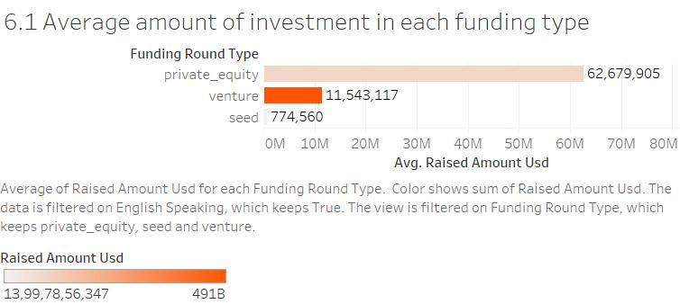
Result (1/3)
• Most Suitable option for Spark Fund within the Range of 5M to 15M of investment will be in Venture Funding

Slide 8
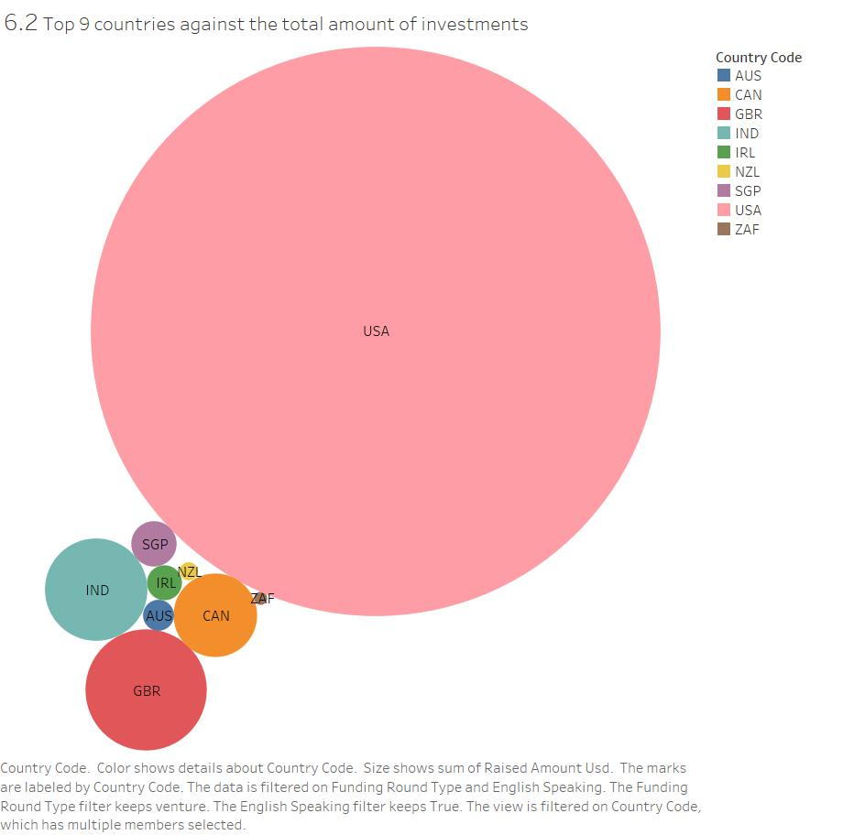
Result (2/3)
Top 9 countries based on the total investment amount are,
Country | Investment in USD
USA | 4,40,67,70,62,249
GBR | 19,98,38,03,406
IND | 14,26,15,08,718
CAN | 9,47,79,99,667
SGP | 2,79,38,97,856
IRL | 1,66,92,85,543
AUS | 1,30,77,88,698
NZL | 44,83,16,383
ZAF | 23,37,13,106
We went ahead with top 3 countries from the above list for further analysis

Slide 9
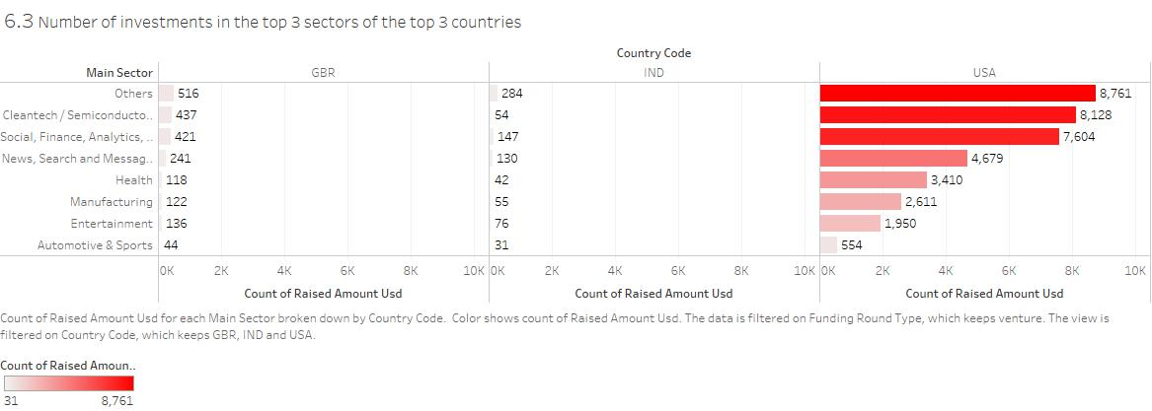
Result (3/3)
Top 3 sectors for Funding are Others, Cleantech/Semiconductors, Social/Finance/Analytics/Advertising

Slide 10
Conclusions
Recommendation
Following are the recommendations,
• Most Suitable option for Spark Fund within the Range of 5M to 15M of investment will be in Venture Funding
• They should look to invest in USA as it has received most amount of funding and is surpassing others by a huge margin. It has received 22 time more investment than second best in the list.
• Most Suitable sectors for Funding are Others, Cleantech/Semiconductors, Social/Finance/Analytics/Advertising in USA

